Slide 1


THE CAREGIVER RELATIONSHIP
2024

Slide 2


THE CAREGIVER RELATIONSHIP
How we approach caregivers is what makes us different
Franchise Affiliate Training

Slide 3

Before you start marketing, check your attitude
How you treat and relate to caregivers is key to your agency’s success
We are trying to change the world of caregiving
We see caregivers as a valuable asset
You are going to be part of something much greater than just an owner of a private duty agency
It boils down to caregivers: take care of them and they will take better care of our clients

Slide 4

THE CAREGIVER OWNS THE “GIG” RELATIONSHIP
Total transparency in pricing
Caregiver manages the relationship
Caregiver is the first point of contact with client
Caregiver gets the lion’s share

Slide 5

YOU HAVE A LARGE POOL OF CAREGIVERS
You will have 100s of caregivers to choose from, and we match online
Wait to hire adults
Discard drama queens pronto
Discard unprofessional caregivers immediately
Mark discarded caregivers as ‘do not hires’

Slide 6
BUILDING THE TRUST RELATIONSHIP
How do you get caregivers to join our “side” when interviewing
Start with the why: Why the founder started this company and the promised he made to his mother
Stress the fact that we pay 2/3s, pay weekly, have instant payouts, and they are W2s.
It is like we pay time and a half all of the time.
We also value their time, so we minimize travel

Slide 7
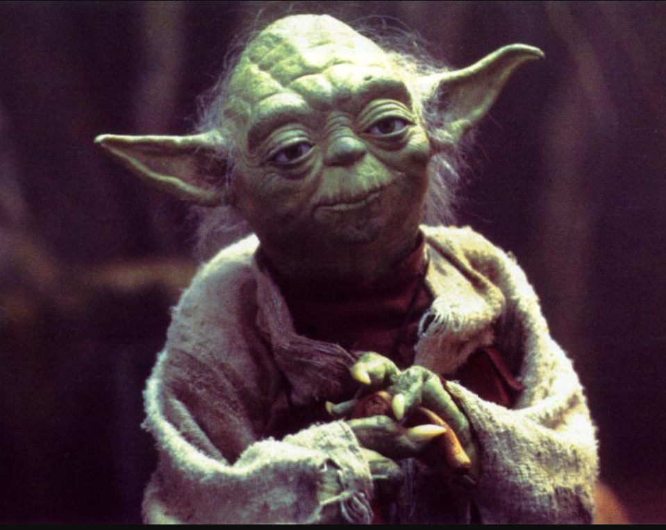
INTERVIEW TIPS AND JEDI MIND TRICKS
Always ask why a caregiver starting caregiving.
If it was because it was a calling, perfect.
Then let them explain their calling
Then ask them, would it not be great to get paid more?

Slide 8
WHY A CAREGIVER SHOULD WORK FOR YOU
Because we hire adults, we never tell a caregiver what to do, we ask if they want to do it
Convey the fact that you do not have an agency without capable and competent caregivers
We pay well, weekly, and electronically
You are part of the team: keep the client happen and you make sure they get paid

Slide 9
HIRE ONLY ADULTS AND PROFESSIONALS
By adult, you mean someone reliable, who communicates when problems arise, who is arrives on time, who does not text / talk on phone, who is attentive to their client, who is kind, skilled in caregiving and does not bring drama into the relationship.
If they prove not to be adults, discontinue the relationship immediately.

Slide 10

HIRING AND ONBOARDING A CAREGIVER
First ask a caregiver if there is anything in the past you should be worried about? Go to Hire Image and order a background check.
Next, send out employment documents via email.
Then meet caregiver at coffee shop, or other location before going to the client’s house to review documents and give some gifts.
Review documents and collect a signed copy, introduce caregiver to client.

Slide 11


Any Questions?!?

