Slide 1


Marketing Strategies for Keep
Safe Care Affiliates
How to Maximize Revenue By Building Your Network for Client Acquisition
2024

Slide 2

Presentation Agenda
Introduction to Keep Safe Care’s USP
Understanding the Market
Target Audience Segmentation
Client Acquisition Strategies
Building Referral Partnerships
Leveraging Community Engagement
Social Media and Content Marketing
Search Engine Optimization (SEO) Basics
Paid Advertising (PPC and Social)
Measuring Success and Key Metrics
Next Steps

Slide 3
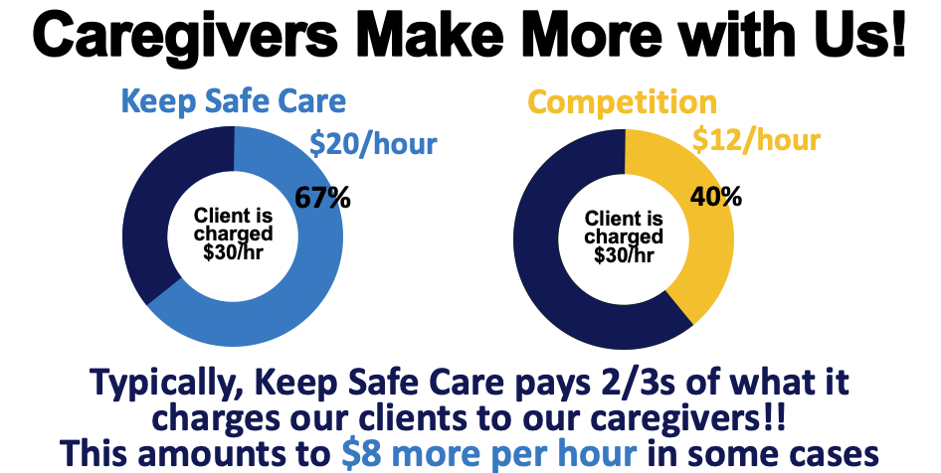
The Keep Safe Care Difference
The 2/3 Rule®: Higher caregiver pay without increasing costs for clients.
Consistent and reliable care (same caregiver each visit).
Sliding fee scale and same-day care availability.
Technological efficiencies to reduce operating costs.
No long-term contracts.

Slide 4
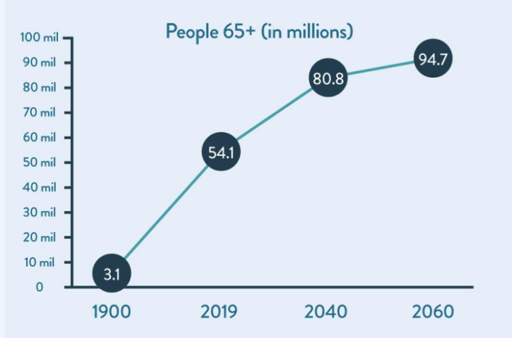
Trends in Home Care and Aging Populations
Growth in the aging population (baby boomers entering retirement age).
Increased demand for in-home care as families seek alternatives to institutional care.
Rise in consumer awareness about caregiver satisfaction and its impact on care quality.
Growing competition in the in-home care space.
Source: A Place for Mom

Slide 5


Identifying Your Ideal Clients and Caregivers
Primary Market
  Elderly individuals, people with chronic conditions or disabilities, and their families.
Secondary Market
  Caregivers looking for better pay and work-life balance.

Slide 6
Proven Methods for Attracting Clients
Referral Programs: Incentivize current clients and caregivers to refer new clients.
Partnerships: Work with local hospitals, rehab centers, and nursing homes.
Community Outreach: Host workshops, sponsor local events, and participate in health fairs.
Highlight Affordability & Consistency: Emphasize the sliding fee scale and the same caregiver model in your marketing messages.

Slide 7
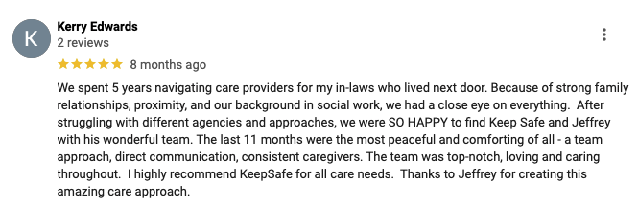
Positioning Keep Safe Care as the Best Choice
Clearly communicate the 2/3 Rule® and its benefits for caregivers and clients.
Use testimonials to build credibility and trust.
Highlight affordability, client satisfaction, caregiver satisfaction, and reliable service.

Slide 8
Creating Valuable Partnerships
Healthcare Providers: Hospitals, rehab centers, doctors, social workers, and senior living facilities.
Senior Centers & Community Groups: Work with senior-focused organizations.
Insurance Providers & Brokers: Partner with insurance companies that offer long-term care insurance.
Offer referral incentives to partners.

Slide 9
Expanding Local Reach through Engagement
Sponsor local events like health expos, senior wellness fairs, or caregiver workshops.
Organize free seminars/webinars on caregiving tips, senior safety, or dementia care.
Collaborate with local media for PR opportunities to increase brand visibility.

Slide 10
Maximizing Your Online Presence
Website Optimization: Clear service offerings, easy navigation, local SEO keywords.
Google My Business: Optimize for local searches; encourage client reviews.
Social Media: Create engaging content (client stories, caregiver highlights) to attract followers.
Email Campaigns: Nurture leads with newsletters, promotions, and success stories.

Slide 11
Engaging Your Audience on Social Media
Platforms: Focus on Facebook, Instagram, and LinkedIn.
Content Ideas: Share caregiver stories, client testimonials, tips for aging, and news about your services.
Engagement: Post consistently, respond to comments, and join relevant local community groups.

Slide 12
Getting Found Online
Optimize your website for local keywords (e.g., "affordable home care in [city]").
Use meta tags, alt text for images, and mobile-friendly design.
Publish blog posts on topics like senior health, caregiving, or tips for aging at home.
Leverage Google My Business to appear in local search results.

Slide 13
Targeting Clients with Paid Advertising
Google Ads: Target local keywords for in-home care services.
Facebook & Instagram Ads: Use geo-targeting to focus on families or individuals in need of home care.
Ad Messaging: Focus on affordability, consistency, and caregiver satisfaction.

Slide 14
Attracting Quality Caregivers
Job Postings: Use Indeed, LinkedIn, and local job boards. Highlight higher pay and flexible scheduling.
Partnerships with CNA Schools: Build relationships with schools to recruit graduates.
Caregiver Testimonials: Use current caregiver stories to show the benefits of working with Keep Safe Care.
Recognition Programs: Offer bonuses, rewards, or growth opportunities to retain top talent.

Slide 15
Expanding Influence through Local Networking
Attend Networking Events: Healthcare industry events, local business meetups, and networking breakfasts.
Host Your Own Events: Invite local leaders, families, and healthcare professionals to your own events.

Slide 16
Tracking Performance to Optimize Revenue
Client Acquisition Metrics: Number of new clients, conversion rates, and lifetime value.
Caregiver Metrics: Recruitment numbers, retention rate, and satisfaction scores.
Digital Marketing Metrics: Website traffic, social media engagement, ROI on paid ads.
Referral Success: Number of referrals from partners and clients.

Slide 17
Avoiding Common Mistakes in Marketing
Neglecting SEO: Not optimizing your website or ignoring local SEO opportunities.
Inconsistent Branding: Lack of clarity in messaging across platforms.
Underutilizing Partnerships: Not fully leveraging relationships with local healthcare providers.
Not Tracking Performance: Failing to measure ROI and adjust strategies accordingly.

Slide 18
Your Path to Growth
Marketing
Community engagement
Partnerships
Caregiver recruitment

Slide 19
Any Questions?!?
2024

